Slide 1
Ratio language and notation
Understanding multiplicative relationships: fractions and ratio

Slide 2
how to use Oak lessons

Slide 3
I can understand and use the language and notation of ratio and use a ratio table to represent a multiplicative relationship and connect this to other known representations.

Slide 4
Proportionality means when variables are in proportion if they have a constant multiplicative relationship.
A ratio shows the relative sizes of 2 or more values and allows you to compare a part with another part in a whole.

Slide 5

Ratio language and notation
Ratio language and notation
Comparing different representations of ratio

Slide 6
Ratio language and notation
Notation in mathematics is very important.
We use symbols and notation because:
they are easier to read and understand
they are concise and take up less space
they can be used to represent complex concepts
it allows mathematical ideas to be communicated more effectively than words

Slide 7
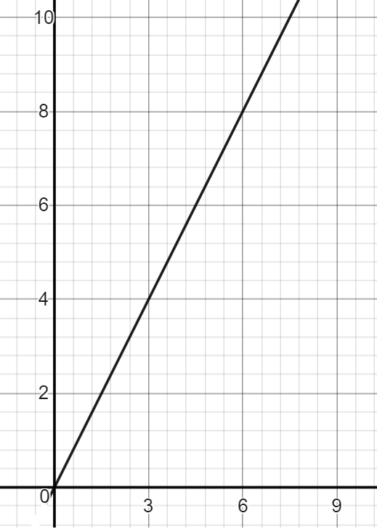
Ratio language and notation
⬜
This can be said with ratio notation too.
For example, here are the different representations of the ratio of circles to squares:
For every 3 circles, there are 4 squares.
⚫ | ⚫ | ⚫ | ⬜ | ⬜ | ⬜ | ⬜
Circles | Squares
3 | 4
⚫

Slide 8
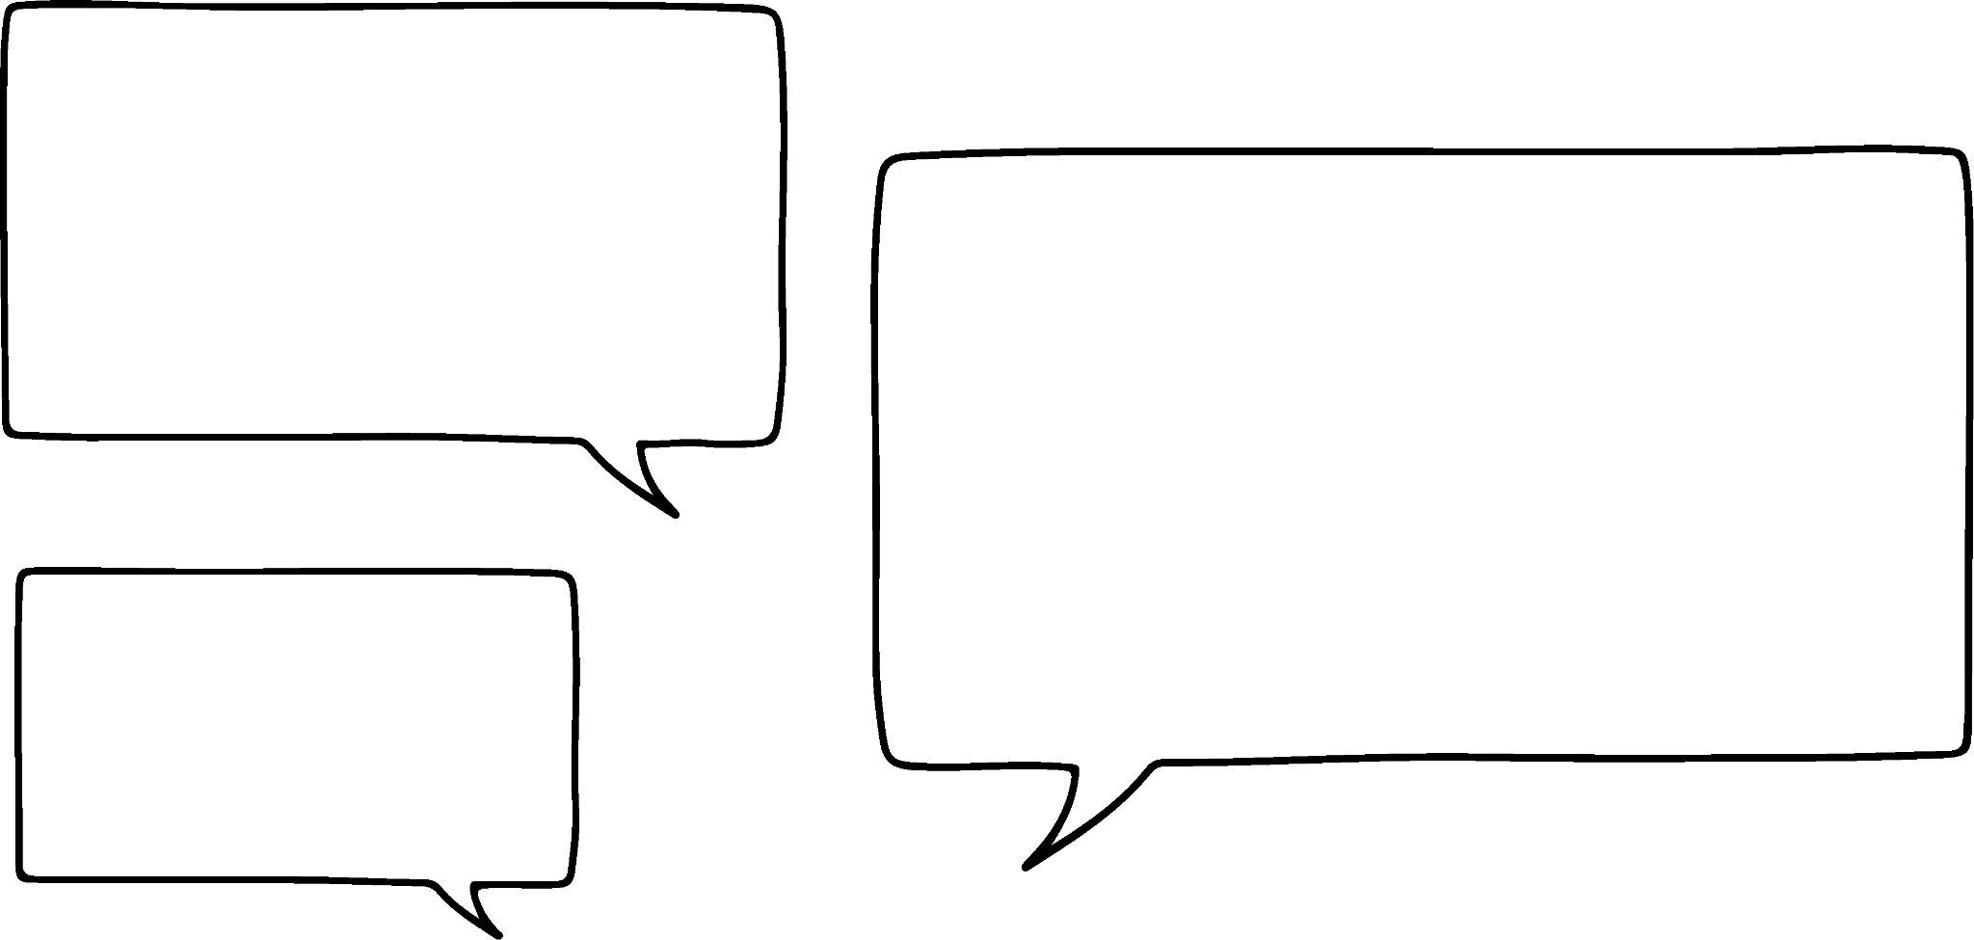
Ratio language and notation
A concise way to write a ratio is to use a colon.
Circles : Squares
3 : 4
We say:
“The ratio of circles to squares is 3 to 4.”
This is much more:
efficient
concise and takes up less space
and uses mathematical notation

Slide 9

Ratio language and notation
Fill in the table. The first has been done for you.
Bar model | Ratio notation | In words
 | Triangles : Squares 1 : 3 | Ratio of triangles to squares is 1 to 3
 | Cats : Dogs 1 : 1 | Ratio of cats to dogs is 1 to 1
 | Apples : Bananas 2 : 3 | Ratio of apples to bananas is 2 to 3
 | Stars : Hearts : Circles 1 : 1 : 2 | Ratio of stars to hearts to circles is 1 to 1 to 2
▲ | ⬛ | ⬛ | ⬛
C | D
A | A | B | B | B
S | H | C | C

Slide 10
Ratio language and notation
The order of the ratio must match between the words and notation.
Bar model | Ratio notation | In words
 | Triangles : Squares 1 : 3 | Ratio of triangles to squares is 1 to 3
 | C : D 1 : 1 | Ratio of C to D is 1 to 1
 | A : B 2 : 3 | Ratio of A to B is 2 to 3
 | S : H : C 1 : 1 : 2 | Ratio of S to H to C is 1 to 1 to 2
▲ | ⬛ | ⬛ | ⬛
C | D
A | A | B | B | B
S | H | C | C

Slide 11
Ratio language and notation
Fill in the gaps for the ratio and the double number line.
Ratio of
R : C
1 : 3
Ratio of
R : C
2 : 3
Ratio of
R : C
5 : 7
1
2
3
2
4
6
5
10
15
R
R
R
C
C
C
3
6
9
3
6
9
7
14
21

Slide 12





Ratio language and notation
÷2
÷3
÷10
Ticks | Crosses
3 | 1
For every 9 ticks, there are 3 crosses.
Ticks | Crosses
30 | 10
For every 3 ticks, there are 1 crosses.
Ticks : Crosses
15 : 5
Ticks : Crosses
3 : 1
All these ratios are the same.
÷5
All these ratios are different as they have different numbers.
Alex
Who is correct? Explain
Alex. When simplified, all the ratio are the same.
Aisha

Slide 13
Ratio language and notation
Is 4 : 6 the same as 2 : 3?
Jun says
“These ratios are the same because 4 × 1.5 = 6
2 × 1.5 = 3”
Lucas says
“These ratios are the same because 4 ÷ 2 = 2
6 ÷ 2 = 3”
Aisha says
“These ratios are different because they have different numbers.”
Jun and Lucas
Who is correct? Explain.

Slide 14
Ratio language and notation
Is 4 : 6 the same as 2 : 3?
Jun says
“These ratios are the same because 4 × 1.5 = 6
2 × 1.5 = 3”
Jun has identified that the multiplier between the parts is 1.5, this means they are equivalent ratios.
Jun and Lucas
Who is correct? Explain.

Slide 15
Ratio language and notation
Is 4 : 6 the same as 2 : 3?
Lucas says
“These ratios are the same because 4 ÷ 2 = 2
6 ÷ 2 = 3”
Lucas has simplified the parts using the highest common factor of 2.
Jun and Lucas
Who is correct? Explain.

Slide 16
Ratio language and notation
Is 4 : 6 the same as 2 : 3?
There are an infinite number of equivalent ratios. All using different numbers, but the multiplicative relationship is the same.
Aisha says
“These ratios are different because they have different numbers.”
Jun and Lucas
Who is correct? Explain.

Slide 17
Ratio language and notation
Fill in the table. The first has been done for you.
Bar model | Ratio notation | In words
 | B : H 3 : 1 | Ratio of B to H is 3 to 1
 | Squares : Circles
 | T-shirts : Shorts
 | Carrots : Apples : Oranges
B | B | B | H
⬛ | ⚫ | ⚫
T | T | S | S | S
C | A | A | O | O

Slide 18
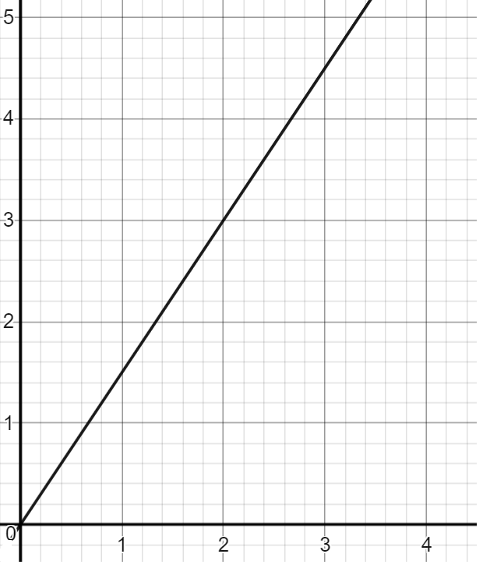
Ratio language and notation
2) All these represent the same ratio. Fill in the blanks.
$
£ | £ | $ | $ | $
£ | $
12 | 18
2
4
6
£ : $
2 : 3
£
$
3
6
9
£

Slide 19
Ratio language and notation
3) Match the ratio table with the ratio notation.
A | B
3 | 10
A | B
30 | 10
A | B
4 | 6
A | B
30 | 50
A | B
60 | 12
A : B
3 : 1
A : B
24 : 80
A : B
15 : 25
A : B
2 : 3
A : B
25 : 5

Slide 20
Ratio language and notation
4) Work out the equivalent ratios.
8 : 10
20 : 25
2 : 2.5
4 : 5
32 : 40
0.4 : 0.5
1 : 1.25

Slide 21
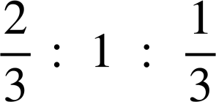
Ratio language and notation
5) Work out the equivalent ratios.
8 : 12 : 4
22 : 33 : 11
10 : 15 : 5
2 : 3 : 1
1 : 1.5 : 0.5
20 : 30 : 10

Slide 22
Ratio language and notation
Fill in the table. The first has been done for you.
Bar model | Ratio notation | In words
 | Books : Hearts 3 : 1 | Ratio of books to hearts is 3 to 1
 | Squares : Circles 1 : 2 | Ratio of squares to circles is 1 to 2
 | T-shirts : Shorts 2 : 3 | Ratio of t-shirts to shorts is 2 to 3
 | Carrots : Apples : Oranges 1 : 2 : 2 | Ratio of carrots to apples to oranges is 1 to 2 to 2
B | B | B | H
⬛ | ⚫ | ⚫
T | T | S | S | S
C | A | A | O | O

Slide 23
Ratio language and notation
2) All these represent the same ratio. Fill in the blanks.
$
£ | £ | $ | $ | $
£ | $
12 | 18
2
4
6
£ : $
2 : 3
£
$
3
6
9
£

Slide 24
Ratio language and notation
3) Match the ratio table with the ratio notation.
A | B
3 | 10
A | B
30 | 10
A | B
4 | 6
A | B
30 | 50
A | B
60 | 12
3 | 1
2 | 3
3 | 5
5 | 1
A : B
3 : 1
A : B
24 : 80
A : B
15 : 25
A : B
2 : 3
A : B
25 : 5
÷8
÷5
÷5
3 : 10
3 : 5
5 : 1

Slide 25
Ratio language and notation
4) Work out the equivalent ratios.
8 : 10
× 2
20 : 25
2 : 2.5
÷ 2
× 5
4 : 5
× 8
32 : 40
÷ 10
0.4 : 0.5
÷ 4
1 : 1.25

Slide 26
Ratio language and notation
5) Work out the equivalent ratios.
8 : 12 : 4
22 : 33 : 11
× 4
10 : 15 : 5
× 5
× 11
2 : 3 : 1
÷ 2
1 : 1.5 : 0.5
× 10
÷ 3
20 : 30 : 10

Slide 27
Ratio language and notation
Ratio language and notation
Comparing different representations of ratio

Slide 28
Comparing different representations of ratio
Knowing the different forms of writing ratios is important as it deepens understanding of how the multiplicative relationship can be seen.
Regardless of how the ratio is represented, the multiplicative relationship is the same for all equivalent ratios. They represent the same proportion.

Slide 29
Comparing different representations of ratio
Can you think of some advantages and disadvantages with using each type of representation?
Ratio representation | Advantages | Disadvantages
Bar model
Graph
Ratio table
Double number line
Ratio notation

Slide 30
Comparing different representations of ratio
Can you think of some advantages and disadvantages with using each type of representation?
You might have said:
Ratio representation | Advantages | Disadvantages
Bar model | Good visual representation | Takes a little time to draw
Graph | Shows lots of equivalent ratios | Accuracy depends on axis
Ratio table | Multipliers can be easily found | Can lose the visual relationships
Double number line | Shows the relationships well | Difficult to get the scale correct
Ratio notation | Efficient and concise | Harder to see relationships

Slide 31

Comparing different representations of ratio
A chocolate bar is made up of 3 parts raisins and 4 parts chocolate. How many grams of raisins will be in a 35 g chocolate bar?
Raisins | Chocolate
3 | 4
Total
7
Using a ratio table
×5
×5
15 g will be raisins
15 | 20
35
Using a ratio notation
Raisins : Chocolate
3 : 4
Total = 7
15 g will be raisins
×5
×5
15 : 20
Total = 35

Slide 32
Comparing different representations of ratio
A orange smoothie is made up of 2 parts orange juice and 3 parts milk.
Laura only has 120 ml of of milk. How much orange juice does she need?
To make a glue, 5 parts are PVA and 2 parts are water.
Andeep only has 20 ml of PVA. How much water should he add to make the glue?
Orange : Milk
PVA : Water
2 : 3
5 : 2
×40
×40
×4
×4
80 : 120
: 120
20 :
20 : 8
Laura needs 80 ml of orange.
Andeep needs 8 ml of water.

Slide 33


Comparing different representations of ratio
In a bag there are only triangles and squares. The ratio of triangles to squares is 4 : 1. There are 40 shapes in total.
Who is correct? Explain where the other pupil made their mistake.
Triangles : Squares
4 : 1
40 : 10
There are 40 triangles and 10 squares.
Triangles : Squares
4 : 1 total = 5
32 : 8 total = 40
There are 32 triangles and 8 squares.
Sam
Sofia
Sofia. Sam misunderstood as there are a total of 40 shapes, not 40 triangles.

Slide 34
Comparing different representations of ratio
Fill in the blanks to complete the work.
Cheese : Tomato
3 : 4
15 : 20
A total of 35 g means there is 15 g of cheese and 20 g of tomato.
b) Yoghurt : Strawberry
5 : 9
20 : 36
A total of 56 ml means there is 20 ml of yoghurt and 36 ml of strawberries.
c) Star : Tick : Square
2 : 3 : 1
12 : 18 : 6
A total of 36 shapes means there are 12 stars, 18 ticks and 6 squares.
× 5
×5
× 4
×4
× 6
×6

Slide 35

Comparing different representations of ratio
2) In a bag, there are only stars and circles. The ratio of stars to circles is 2 : 3
If there are 20 stars, how many circles are there?
If there 65 shapes in total, how many stars are there?

Slide 36

Comparing different representations of ratio
3) The chocolates in this box either have red or blue wrappers.
The ratio of red to blue is 2 : 1
If there are 10 red chocolates, how many blue chocolates are there?
If there are 10 blue chocolates, how many red chocolates are there?
Is it possible for there to be 10 chocolates in total? Why or why not?
There are 10 more red chocolates than blue. How many are there in total?

Slide 37
Comparing different representations of ratio
Fill in the blanks to complete the work.
Cheese : Tomato
3 : 4
15 : 20
A total of 35 g means there is 15 g of cheese and 20 g of tomato
b) Yoghurt : Strawberry
5 : 9
20 : 36
A total of 56 ml means there is 20 ml of yoghurt and 36 ml of strawberries.
c) Star : Tick : Squares
2 : 3 : 1
12 : 18 : 6
A total of 36 shapes means there are 12 stars, 18 ticks and 6 squares.
× 5
×5
× 4
×4
× 6
×6

Slide 38
Comparing different representations of ratio
2) In a bag, there are only stars and circles. The ratio of stars to circles is 2 : 3
If there are 20 stars, how many circles are there?
If there 65 shapes in total,
how many stars are there?
stars : circles
2 : 3
20 : 30
30 circles
× 10
×10
stars : circles
2 : 3 total = 5
26 : 39 total = 65
× 13
×13
26 stars

Slide 39
Comparing different representations of ratio
3) The chocolates in this box either have red or blue wrappers.
The ratio of red to blue is 2 : 1
If there are 10 red chocolates, how many blue chocolates are there?
red : blue
2 : 1
10 : 5
× 5
×5
There are 5 blue.

Slide 40
Comparing different representations of ratio
3) The chocolates in this box either have red or blue wrappers.
The ratio of red to blue is 2 : 1
b) If there are 10 blue chocolates, how many red chocolates are there?
red : blue
2 : 1
20 : 10
× 10
× 10
There are 20 red.

Slide 41
Comparing different representations of ratio
3) The chocolates in this box either have red or blue wrappers.
The ratio of red to blue is 2 : 1
c) Is it possible for there to be 10 chocolates in total? Why or why not?
No, as the total parts for chocolates is three. 10 is not a multiple of three. Every two red needs one blue, meaning that chocolates are ‘added’ in groups of three.

Slide 42
Comparing different representations of ratio
3) The chocolates in this box either have red or blue wrappers.
The ratio of red to blue is 2 : 1
d) There are 10 more red chocolates than blue. How many are there in total?
red : blue
2 : 1
20 : 10
× 10
× 10
There are 20 red and 10 blue. This makes a difference of 10 chocolates between red and blue.

Slide 43
Ratio language and notation
We use symbols and notation because: they are easier to read and understand, they are concise and take up less space, they can be used to represent complex concepts and it allows mathematical ideas to be communicated more effectively than words.
Ratio notation allows us to represents bar models, ratio tables, graphs and double number lines in a concise and efficient way.

Slide 44

© Oak National Academy 2023.
Produced in partnership with Mathematics in Education and Industry.
Licensed on the Open Government Licence v3.0, except where otherwise stated. See Oak terms and conditions.

